Slide 1
Patient Diagnosis with Machine Learning
Caitlin Ortega Ruble

Slide 2

How Diagnosis is Done
Data: Symptoms, Test Results, Etc.
Diagnosis
Treatment
Doctor's Knowledge
Notes:
Tell story of the sick Dodo bird
Bird goes to doctor, that doctor uses two things (CLICK):
Data about symptoms, lab results, family history, etc + their knowledge to come up with…(CLICK)
A diagnosis. (CLICK)
That diagnosis leads to treatment, which, hopefully resolves the illness so our Dodo bird can feel better and get on with its life

Slide 3

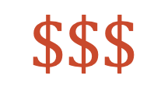
How can it go wrong?
Prolonged Suffering
Data: Symptoms, Test Results, Etc.
$$Σ$$
Diagnosis
Mis-diagnosis
Treatment
Wrong Treatment
$$\$\$\$$$
Doctor's Knowledge
Doctor's Knowledge
Severe Illness and Death
Notes:
We all know doctors are very smart people. They study for years to memorize vast quantities of medical data, gain first hand experience practicing medical theory with patients and continue to gain experience through their years of practicing medicine.
However, they are also people, and not walking encyclopedias of medical knowledge. They are subject to the fallibilities of being human.
So let’s say that there is a flaw or gap in a doctor’s knowledge or reasoning. (CLICK)
And let’s say this gap leads to a misdiagnosis for the patient. (CLICK)
Which in turn leads to the wrong treatment. (CLICK)
At best, this leads to prolonged suffering (CLICK)
At worst, this leads to severe illness and even death
And the Sum of all this is suffering and a lot of money (CLICK)

Slide 4
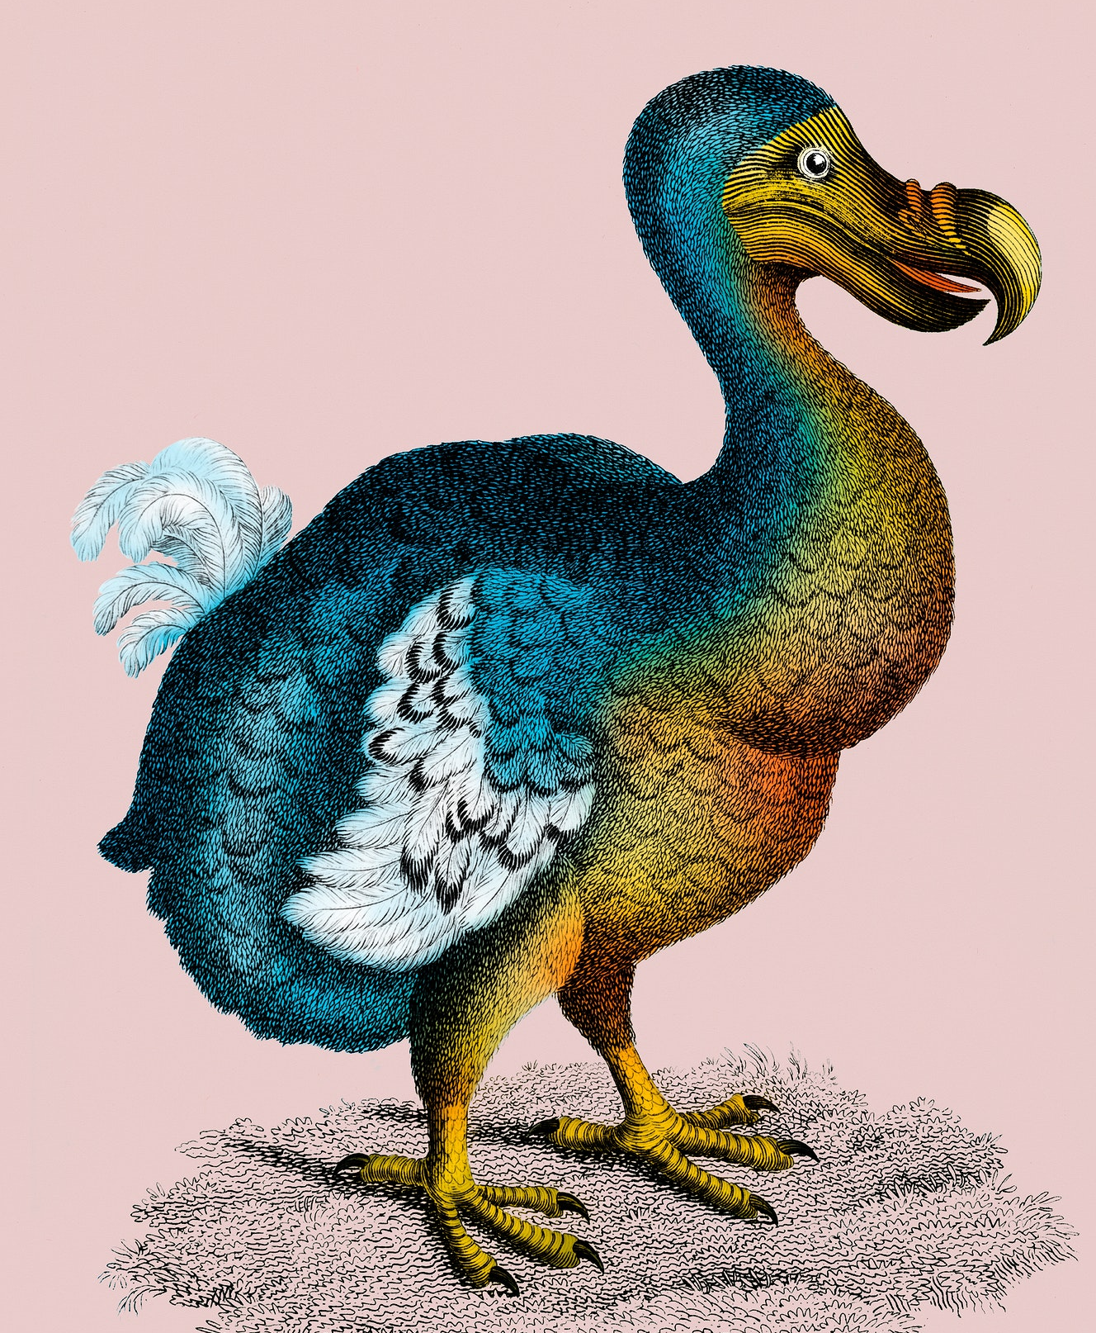
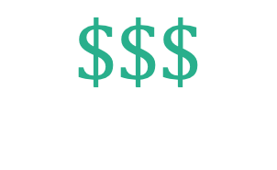
What can we do?
Data: Symptoms, Test Results, Etc.
$$\$\$\$$$
Right Diagnosis
Mis-diagnosis
Right Treatment
Wrong Treatment
Doctor's Knowledge
Machine Learning Model
Notes:
SO, what can we do?
Well, my proposal is to replace that error-prone doctor knowledge component with a machine learning model (CLICK)
That takes that symptom data and gives (CLICK) the right diagnosis
In turn leading to the (CLICK) right treatment
Which saves a lot of money(CLICK), a lot of suffering, and, of course (CLICK) healthy patients with better outcomes.

Slide 5
The data
Kaggle dataset: "Disease Prediction Using Machine Learning"
133 columns,

Slide 6
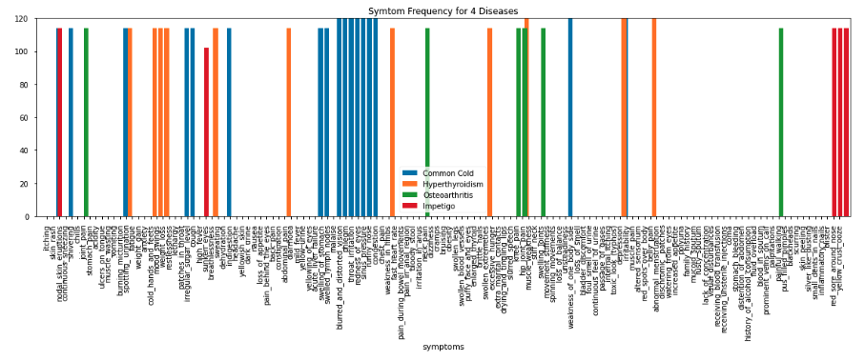

Slide 7
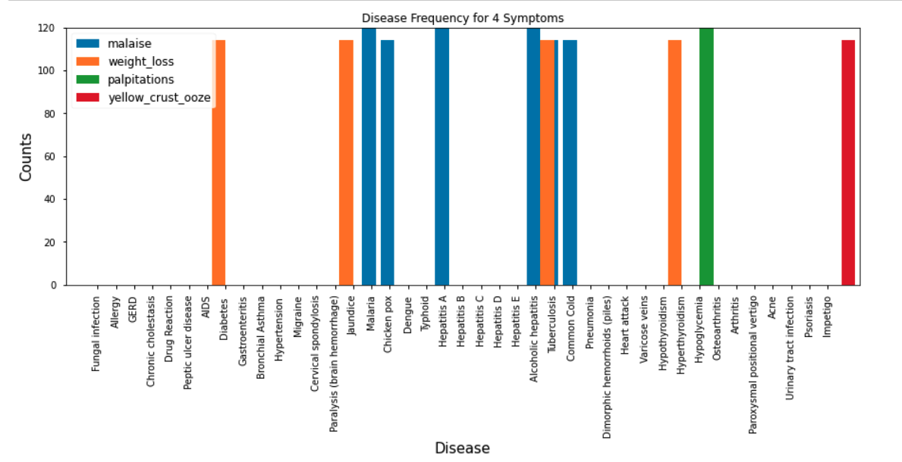

Slide 8
Data Handling
Duplicate Features
Label Encoding

